Slide 1
SIR on Networks
Sergi Valverde
COMPLEX DISEASES

Slide 2
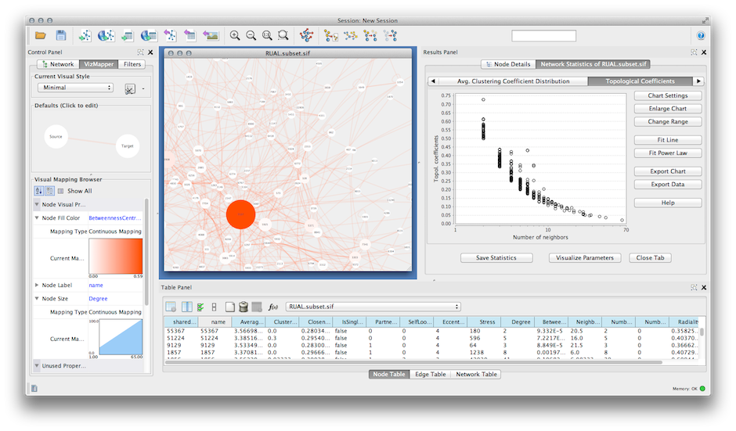

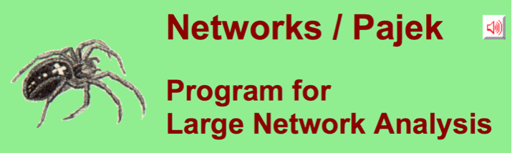
Network Visualisation & Analysis

Slide 3
https://sites.google.com/site/introcomplexnetworks/

Slide 4
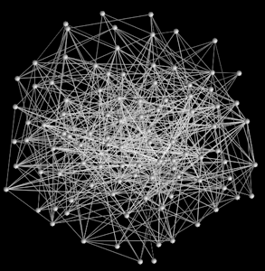
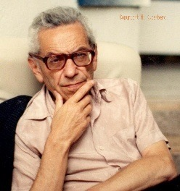

Random Graphs
Pál Erdös
(1913-1996)
Notes:
Random networks
The study of networks is not anew. Erdos and Renyi, two hungarian mathematicians, created the random network theory in the 1960s. They proposed the most simple approximation to model a very complex networks. When you don't know the exact details of complicated interactions between technologies, the simplest approximation is to assume these interactions happen at random.
Random theory was born. A random graph has a random set of nodes and places links between nodes at random. For example, there is a component of chance in what people we meet every day. Also, encounters between insects or molecules happen at random.

Slide 5
ErdosRenyi.nlogo

Slide 6
How it works?
who
thiswho
p
Notes:
check function all-random

Slide 7
How it works?
create-link-with myself
caller
myself
Notes:
create-link-with creates an undirected link between the caller and agent. create-link-to creates a directed link from the caller to agent. create-link-from creates a directed link from agent to the caller.

Slide 8
How it works?
create-link-with myself
thiswho
who
p
Notes:
check function all-random

Slide 9
How it works?
thiswho
p
who
Notes:
check function all-random

Slide 10
How it works?
thiswho
Notes:
check function all-random

Slide 11
How it works?
Notes:
check function all-random

Slide 12
Notes:
Let’s look at a Netlogo simulation of the ER GRAPH
Looks like a Hairball => Network Layout

Slide 13
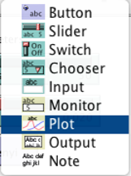

Slide 15
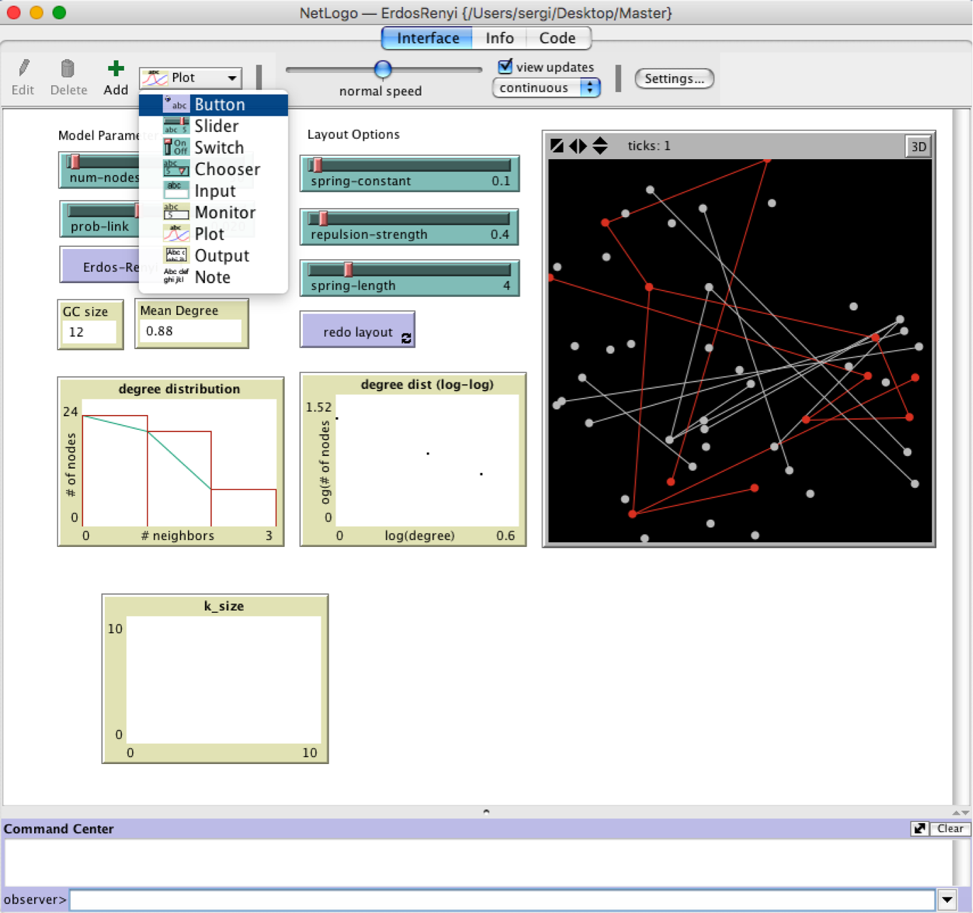

Slide 19
Average Degree
As the size N of the network increases, if you keep p, the probability of any two nodes being connected, the same, what happens to the average degree <k>?
p = 0.02
?

Slide 20

Average Degree
As the size of the network increases, if you keep p, the probability of any two nodes being connected, the same, what happens to the average degree <k>?
p = 0.02

Slide 21
SCALE-FREE

Slide 22
Epidemics on Networks

Slide 23
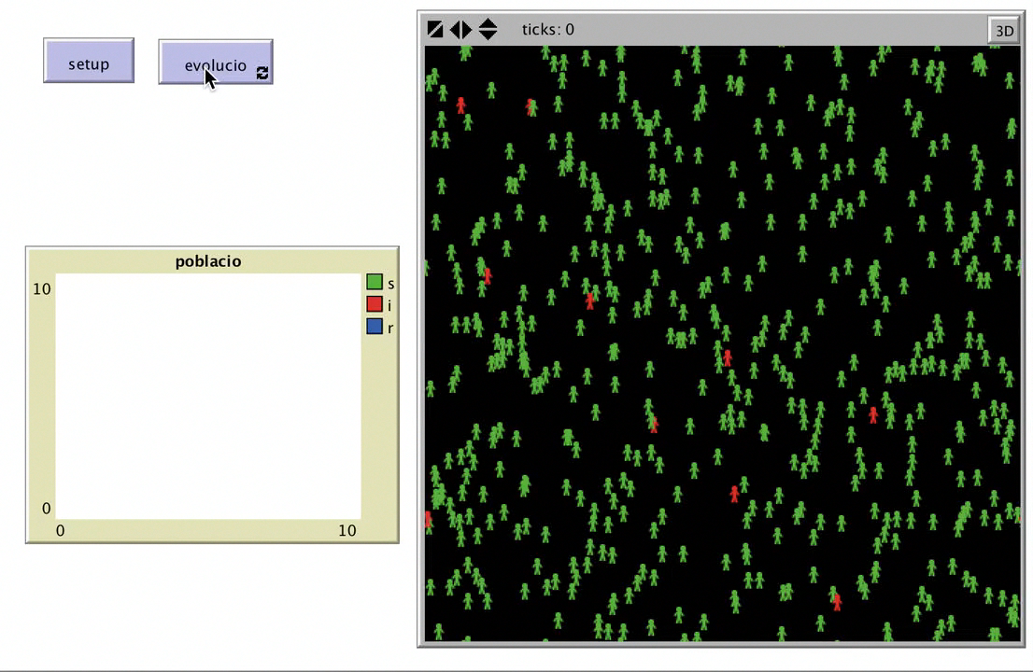
Previously…

Slide 24
SI on Random Graphs
Notes:
to infect
ask link-neighbors with [color != red]
[
if random-float 1 < prob-infection ;; virus-spread-chance
[
;; become-infected
set color red
]
]
end
layout-spring (turtles with [any? link-neighbors]) links 0.1 2 0.4

Slide 25
Project
Implement the SIR model
Study Epidemics on Random, Lattice & Scale-Free Networks
Design effective vaccination strategies for each network.
Notes:
Scale-free are an example of “growth network”

